Slide 1
Concurrency Control Techniques

Slide 2
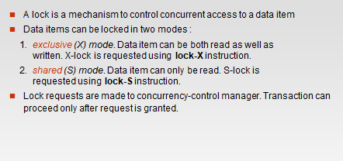
Lock Based Protocols

Slide 3
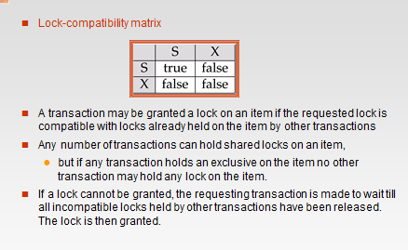
Lock Based Protocols

Slide 4
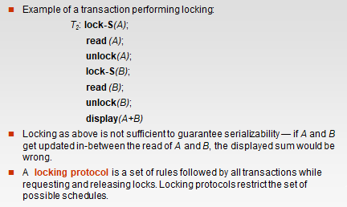
Lock Based Protocols

Slide 5
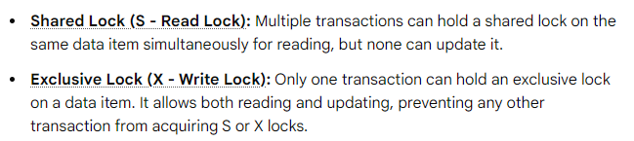
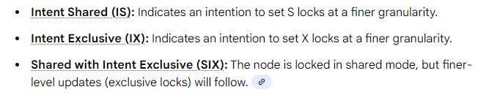
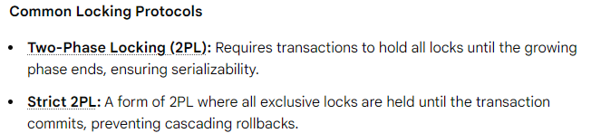
Different locks modes:

Slide 6
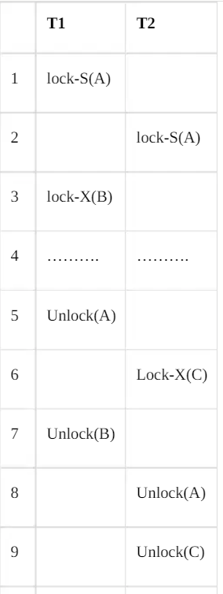
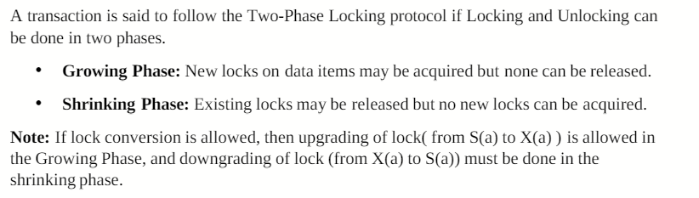
Two Phase Locking Protocol

Slide 7
Multiple Granularity
Multiple granularity locking is a locking mechanism that provides different levels of locks for different database objects. It allows for different locks at different levels of granularity. This mechanism allows multiple transactions to lock different levels of granularity, ensuring that conflicts are minimized, and concurrency is maximized.
To illustrate, let's consider a tree structure that has four levels of nodes. The top level represents the entire database, and below it are nodes of type "area", which represent specific areas of the database. Each area has child nodes called "files", and each file represents a specific subset of data within that area. Importantly, no file can span more than one area.
Finally, each file has child nodes called "records", which represent individual units of data within the file. Like files, each record is a child node of its corresponding file and cannot be present in more than one file.
Database
Area
File
Record

Slide 8
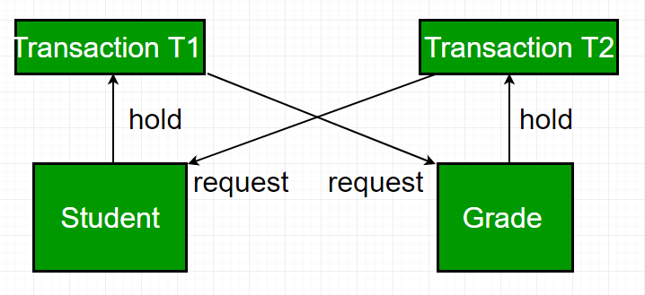
Deadlock:
A deadlock occurs in a multi-user database environment when two or more transactions block each other indefinitely by each holding a resource the other needs. This results in a cycle of dependencies (circular wait) where no transaction can proceed.
T1 locks Resource "Student" and needs Resource "Grade"
T2 locks Resource "Grade" and needs Resource "Student"
T1 waits for T2, T2 waits for T1, hence resulting in a deadlock

